Slide 1

Zillow Real Estate Data
By: Liwen Li

Slide 2
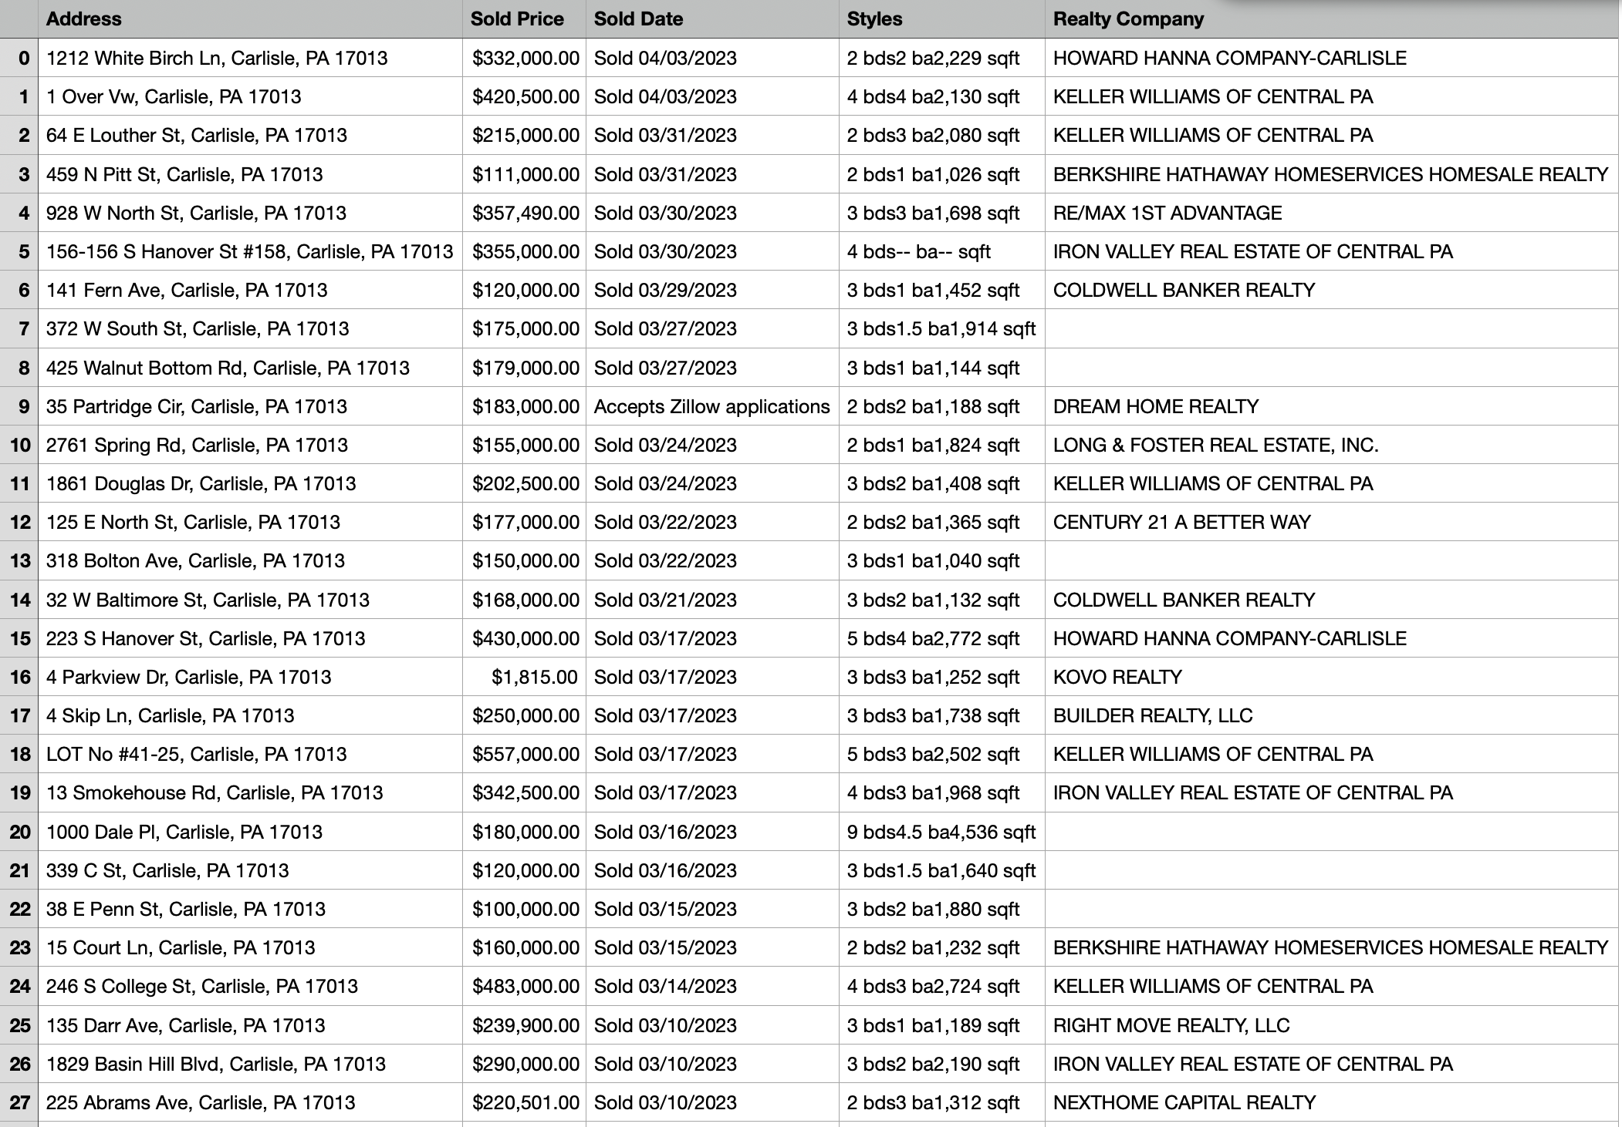
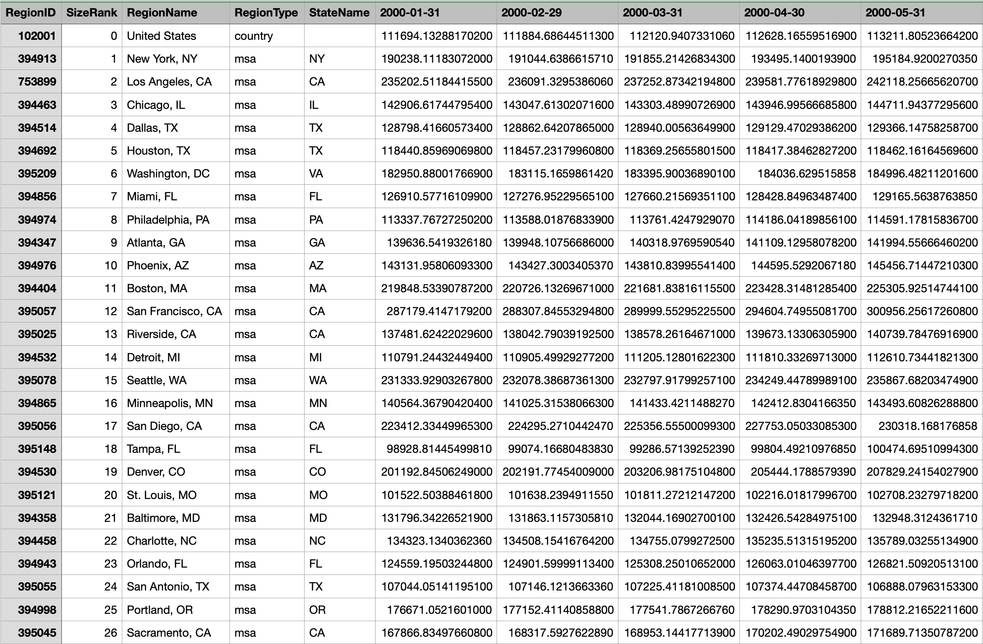
Dataset
762 dataset, oldest dataset to 02/25/22
Home Value of Metro
List of Sales Price

Slide 3
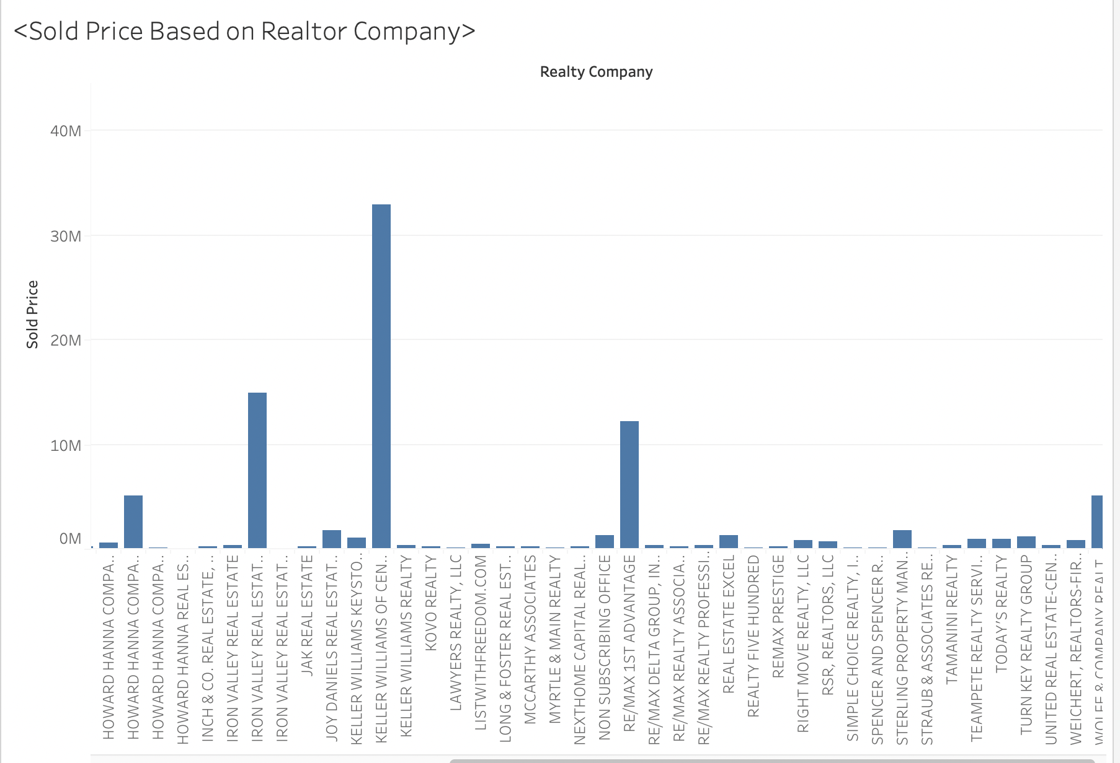

Slide 4
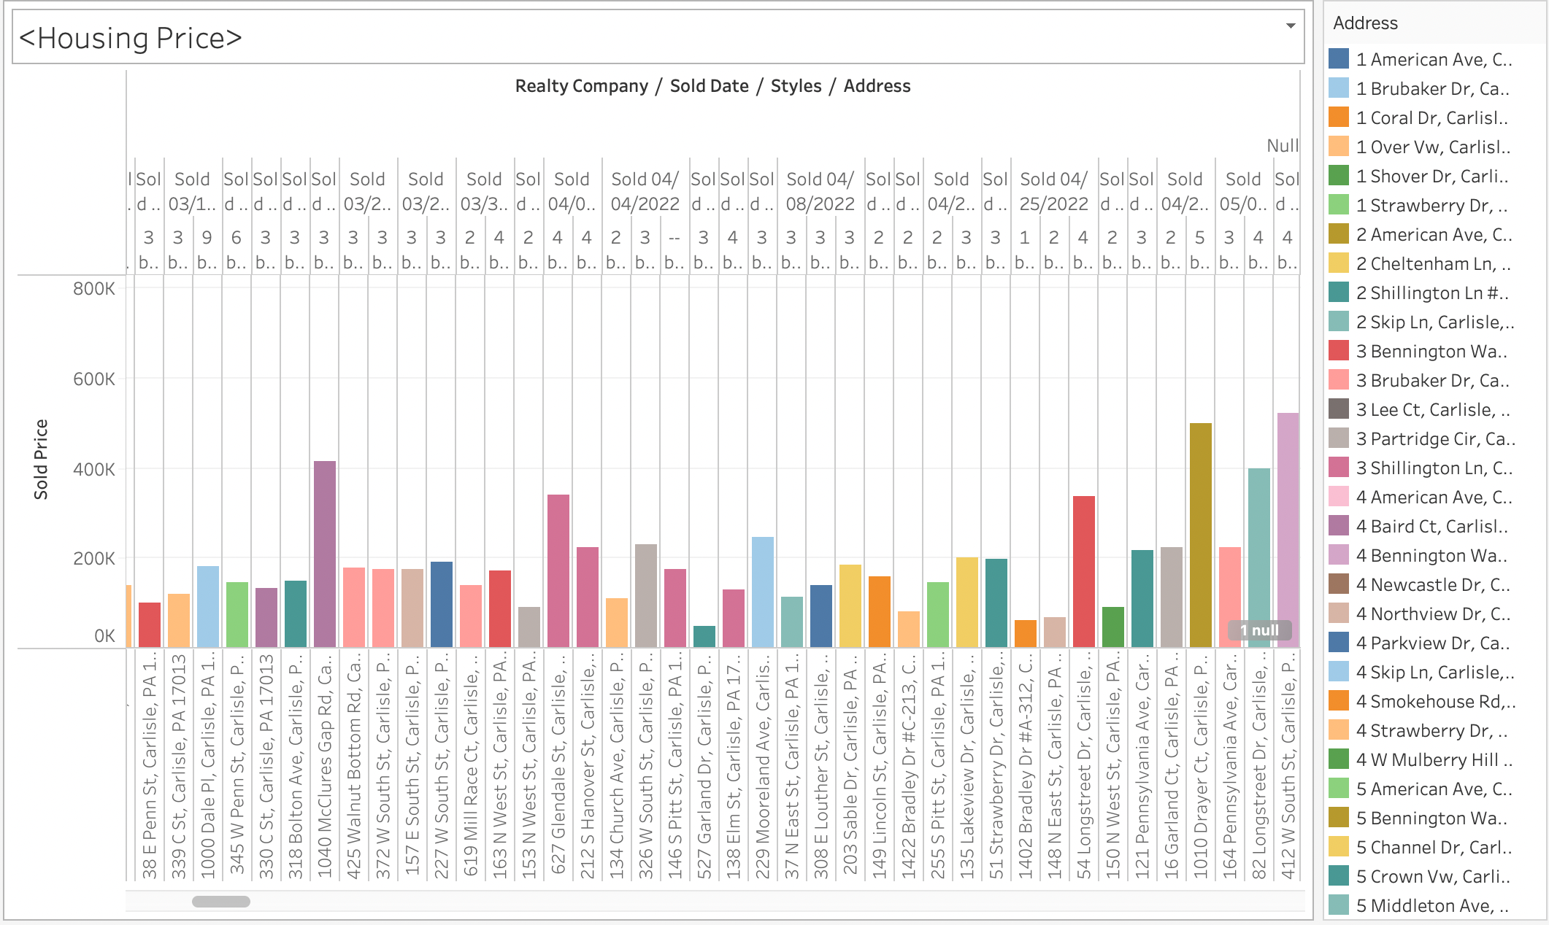

Slide 5
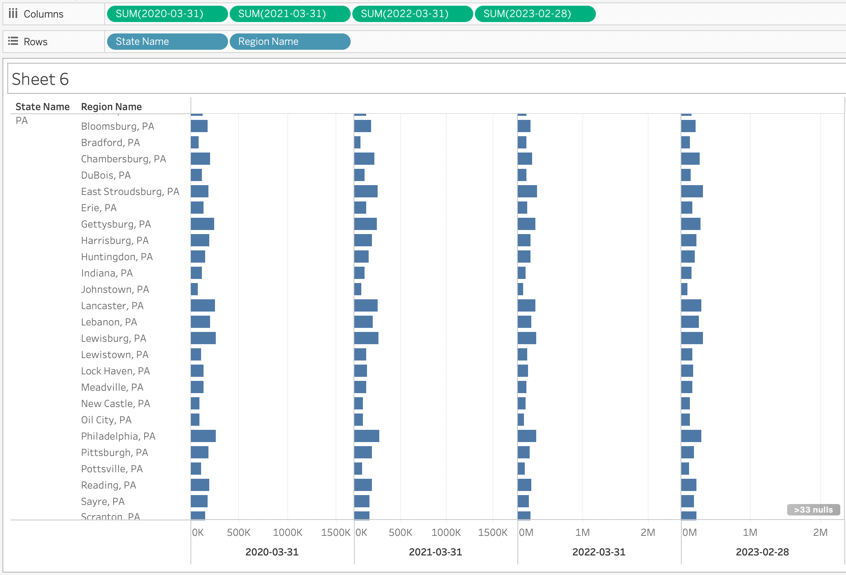

Slide 6
